Slide 1
Amazon Sales Data Analysis
Name – Abhishek Sahu
Roll. No. – 23N0458

Slide 2
Objective
In this project, we want to study Amazon sales info like product names, category, ratings, and user reviews. We aim to find out what customers like, figure out trends, and see how well products are doing. By looking at this data, we hope to understand what people prefer and how they usually shop on Amazon.

Slide 3
Data Overview
Features
Product id - Product ID
Product name - Name of the Product
category - Category of the Product
Discounted price - Discounted Price of the Product
Actual price - Actual Price of the Product
Discount percentage - Percentage of Discount for the Product
rating - Rating of the Product
Rating count - Number of people who voted for the Amazon rating
About product - Description about the Product
User id - ID of the user who wrote review for the Product
Username - Name of the user who wrote review for the Product
Review id - ID of the user review
Review title - Short review
Review content - Long review
Img link - Image Link of the Product
Product link - Official Website Link of the Product

Slide 4
Dataset
"For the foundation of our analysis, we curated our Amazon sales data from Kaggle, a reputable repository for datasets. Leveraging this rich and diverse source, we aim to unveil nuanced insights into the intricate dynamics of e-commerce, providing a robust basis for our findings and recommendations.“
data have 1463 rows and 16 columns

Slide 5
Libraries Used
Pandas
Numpy
Matplotlib
seaborn

Slide 6
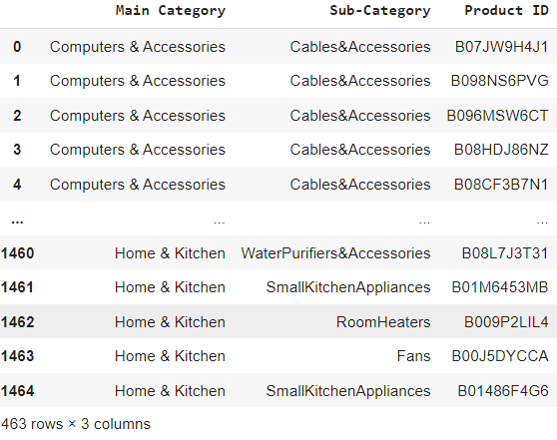
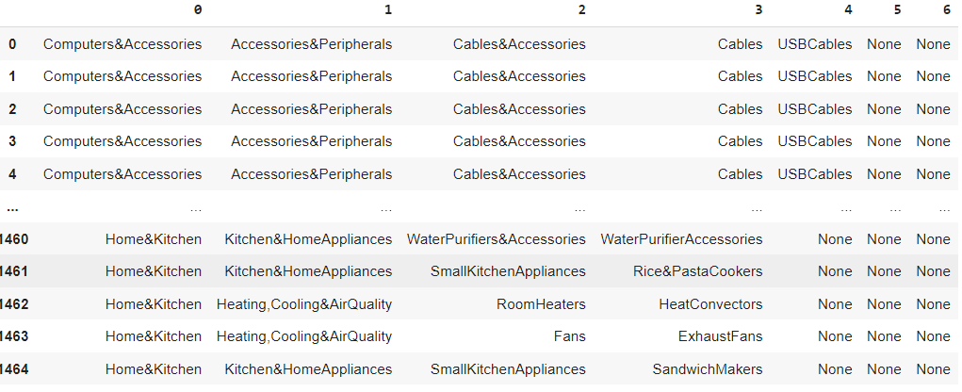
Data Cleaning and Preparation
Changing Data Types of Columns from object to Floats
Filling in Missing Information
Checking For Duplicate Rows
Splitting Long Strings – splitting some columns data using code for better analysis

Slide 7
Exploratory Data Analysis (EDA) + Data visualization
Analyze the distribution of products by category using a bar plot or histograms
Analyze the distribution of customer ratings using a histogram or bar plot
make correlation matrices

Slide 8
Distribution of products by main category and subcategory
Electronics, Computers & Accessories, and Home & Kitchen emerge as the top three customer-favored categories, underscoring their widespread popularity among our diverse customer base.
Office Products, Musical Instruments, Home Improvement, Toys & Games, Car & Motorbike, and Health & Personal Care have a very small number of products, which may suggest that these categories have less demand.
In subcategories cables and accessories, kitchen appliances mobile accessories are top sold products, we conclude that these products are more in trend and more popular according to other hard drive accessories and flashes and video cameras etc have less demand

Slide 9
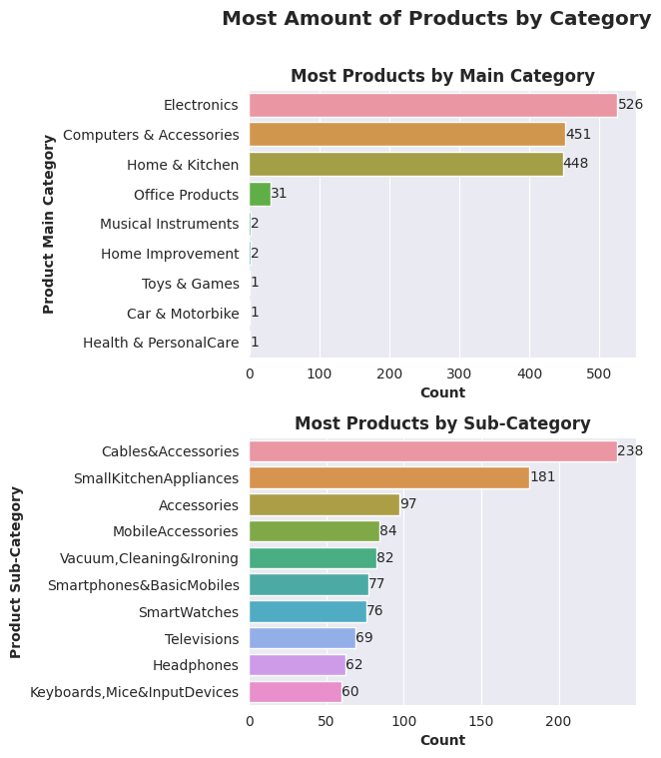
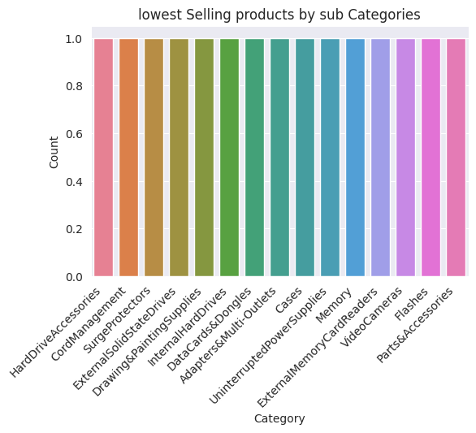

Slide 10
Top main categories and subcategories by Rating
toy and games, home and improvement are the highest rating products but these are lowest selling products also as we can say that products are good in quality and satisfies the customer expectation
We can see that computers and accessories, electronics has rating more than 4 which shows that this products are well liked and meet the expectation of the customers
On the other hand, the main categories with lower ratings are Car & Motorbike, Musical Instruments, and Health & Personal Care, with ratings below 4.0. This could indicate areas where improvements could be made to better meet customer expectations.
In subcategories calculators and air conditioners are highest rating which shows that this products are meet the expectation of customers(this products are not most soled products by the customers)

Slide 11
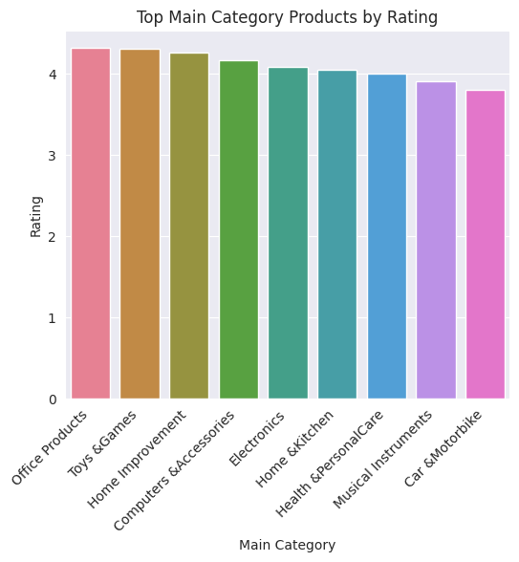
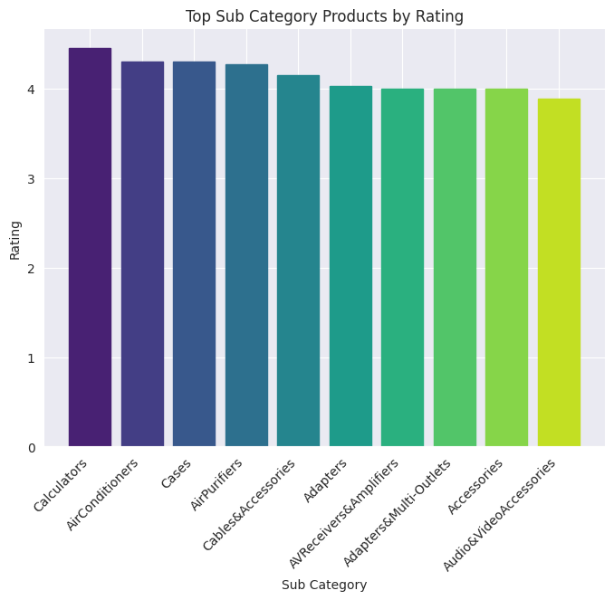

Slide 12
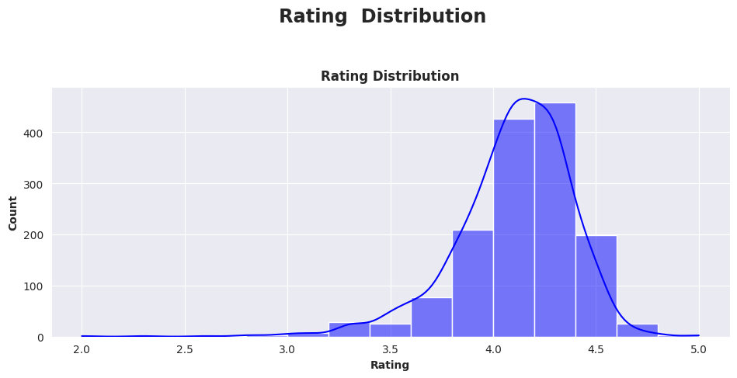
Distribution Of Customer Rating
The majority of customer ratings fall within the 3-4 and 4-5 range
There is a noticeable increase in the number of reviews in the 2-3 range compared to the lower 1-2 ranges.
Overall, the distribution of customer ratings suggests that most customers are satisfied with the products, but there may be opportunities for improvement to increase the number of positive ratings.

Slide 13
Analyzing main category product by ratings Score
Making some assumption to understand the performance of products through the ratings
1. **Score below 2.0 = Poor** 2. **Score range of 2.0 - 2.9 = Below Average** 3. **Score range of 3.0 - 3.9 = Average** 4. **Score Range of 4.0 - 4.9 = Above Average** 5. **Score of 5.0 = Excellent**
With this assumption we can analyze how many main category products are below average and below average

Slide 14
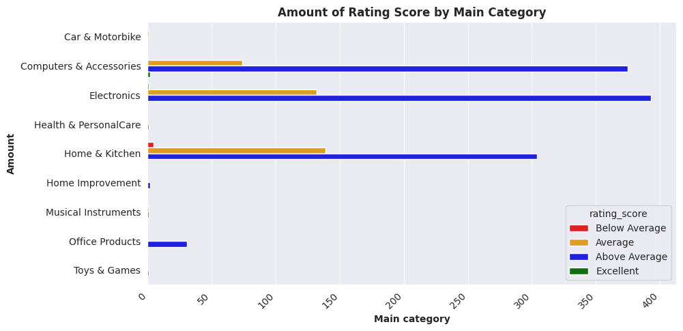
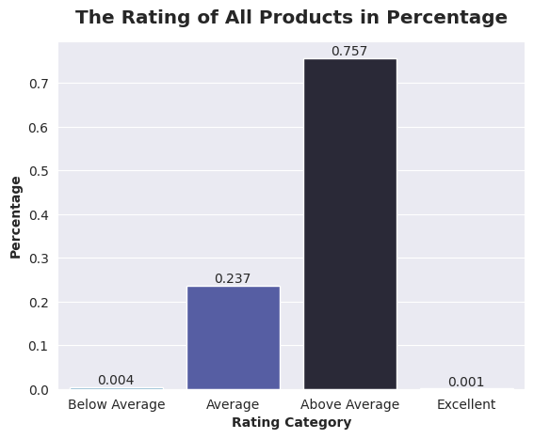
Analysis by rating score
The majority of computer, electronics and home kitchen products in the dataset receive ratings above the average, indicating a general satisfaction among customers in these categories.
Notably, no products in the dataset are rated as Poor, underscoring a positive trend in customer satisfaction across the considered product categories.
Overall, the prevalence of above-average ratings signals a high degree of contentment among customers, pointing towards the overall success and quality of the computer electronics and home kitchen products in the dataset.

Slide 15
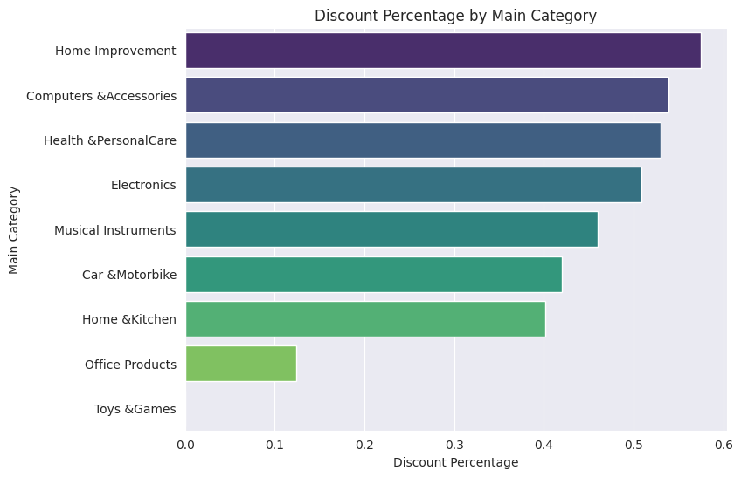
Analysis of Discount By main category
The category with the lowest mean discount percentage is Toys & Games, with a value of 0.0. This may indicate that the either the toys are In sufficient demand or they are not price sensitive
The categories with the highest mean discount percentages are Home Improvement, Computers & Accessories, and Electronics, respectively. This may indicate that these categories are more price-sensitive, and retailers need to offer attractive discounts to compete effectively.

Slide 16
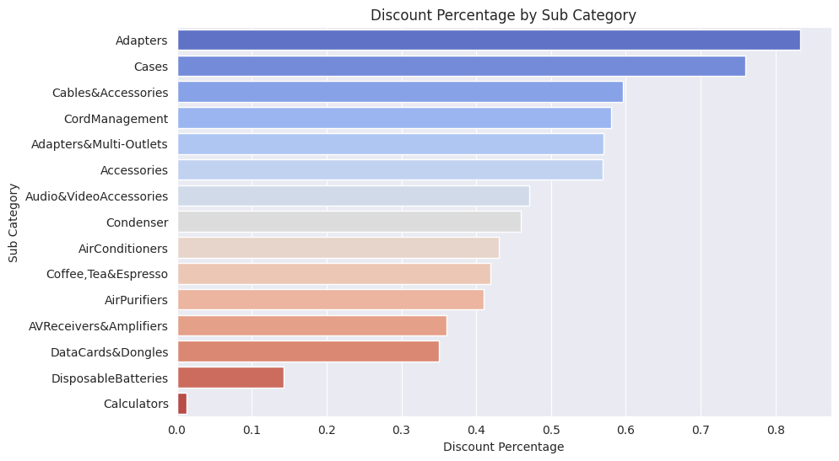
Analyze the discount by subcategory
Adaptors, cases, Cables and accessories are most discounted items in the product which shows that these are the highest price sensitive products and have most competition in the market
Calculators and disposable batteries and may items in the product have the less discount this shows that this products are either sufficient in the demand or have less profit margin

Slide 17
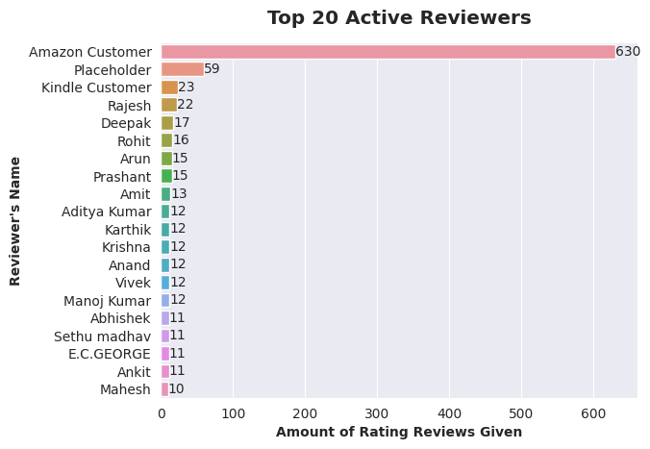
Analysis of Active Reviewers
The bar Plot shows the active reviewers

Slide 18
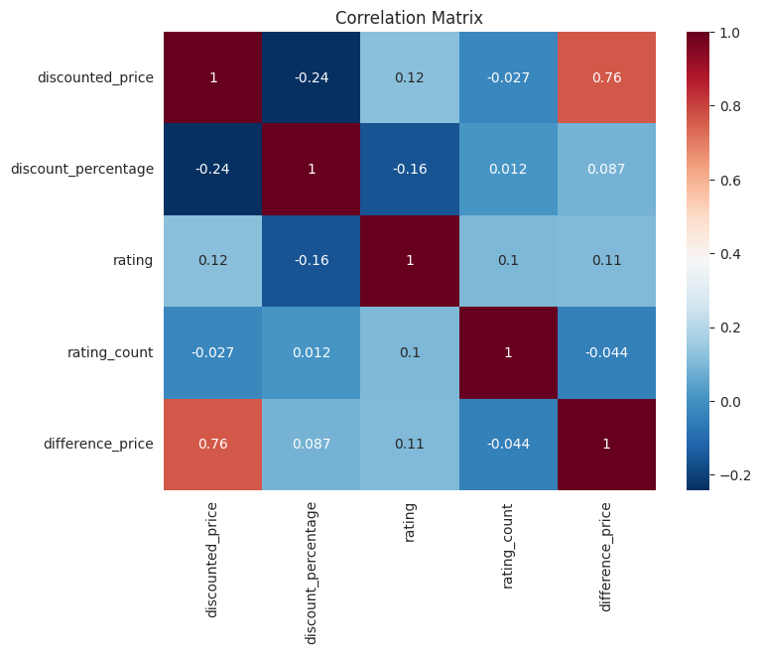
Co-Relation Matrix
There is a moderate negative correlation between discounted price and discount percentage (-0.24). This indicates that higher discounts are associated with lower discounted prices.
The difference in price has a positive correlation with both the discounted price (0.76) and the discount percentage (0.09). This implies that higher price differences are associated with higher discounted prices and.

Slide 19
Conclusion
Now we see products like computer and accessories, electronics, home & kitchen products are more popular than other products and also We noticed that even the products which have not been sold much have good ratings which shows that customers are very satisfied with the products. But the rating of some products which are in regular demand is not good. Their quality will have to be improved to achieve good sales in future.

Slide 20
Insights
Unlocking customer preferences involves delving into individual purchase histories to pinpoint the categories and features that resonate most with each user. By meticulously analyzing these patterns, we gain invaluable insights that serve as a compass for refining product designs and tailoring marketing strategies. This approach enables us to finely target specific customer segments, ensuring our products align seamlessly with their preferences and desires.
By suggesting relevant products to users based on their interests, we can increase their engagement with the platform and their satisfaction with the shopping experience. This can lead to higher customer retention and loyalty
.

Slide 21
Thankyou

